Slide 1
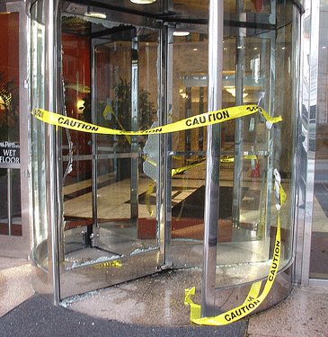
A New Look at Rotary Membership Our Members Are Our Customers Fixing the Rotary Revolving Door! Prepared for Mid-South PETS by: Zone 30 ARC Brent D. Rosenthal PDG Rotary District 6690

Slide 2
Change
“This is a changing world; we must be prepared to change with it. The story of Rotary will have to be written again and again.”
Paul Harris, 1935

Slide 3
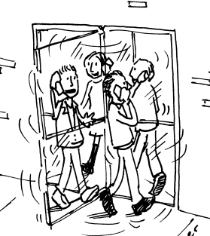
Rotary Membership in North America*
44,000 join each year
51,000 members leave
Net loss: >280,000 since 1 July, 2007
Attrition rate (11-12) :12%
(up from 10.8% in 07-08).
* Source: North American Membership Strategic Plan (April 2012)

Slide 4
Of Those Who Leave
33% - members less than 1 year
50% - members less than 2 years
80% - members for less than 5 years
14% - “demographics” (death, relocation, etc.)
We can’t prevent demographics!

Slide 5
So What Does That Tell Us?
We get enough new members every year to grow a lot!
We don’t do a good job of keeping our members.
Rotary’s membership problem cannot be fixed by recruiting alone.
We are failing our newest members.

Slide 6
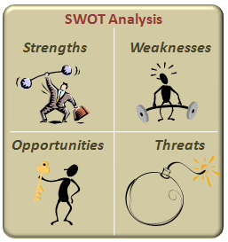
SWOT Analysis
Strengths: *positive brand and prestige; *great Rotarians who love Rotary; *universal appeal of Service Above Self.
Weaknesses: *high member attrition rate; *outdated packaging.
Threats: *changing world; *internal resistance to change.
Opportunity/Challenge: retool Rotary to fit today’s world!

Slide 7
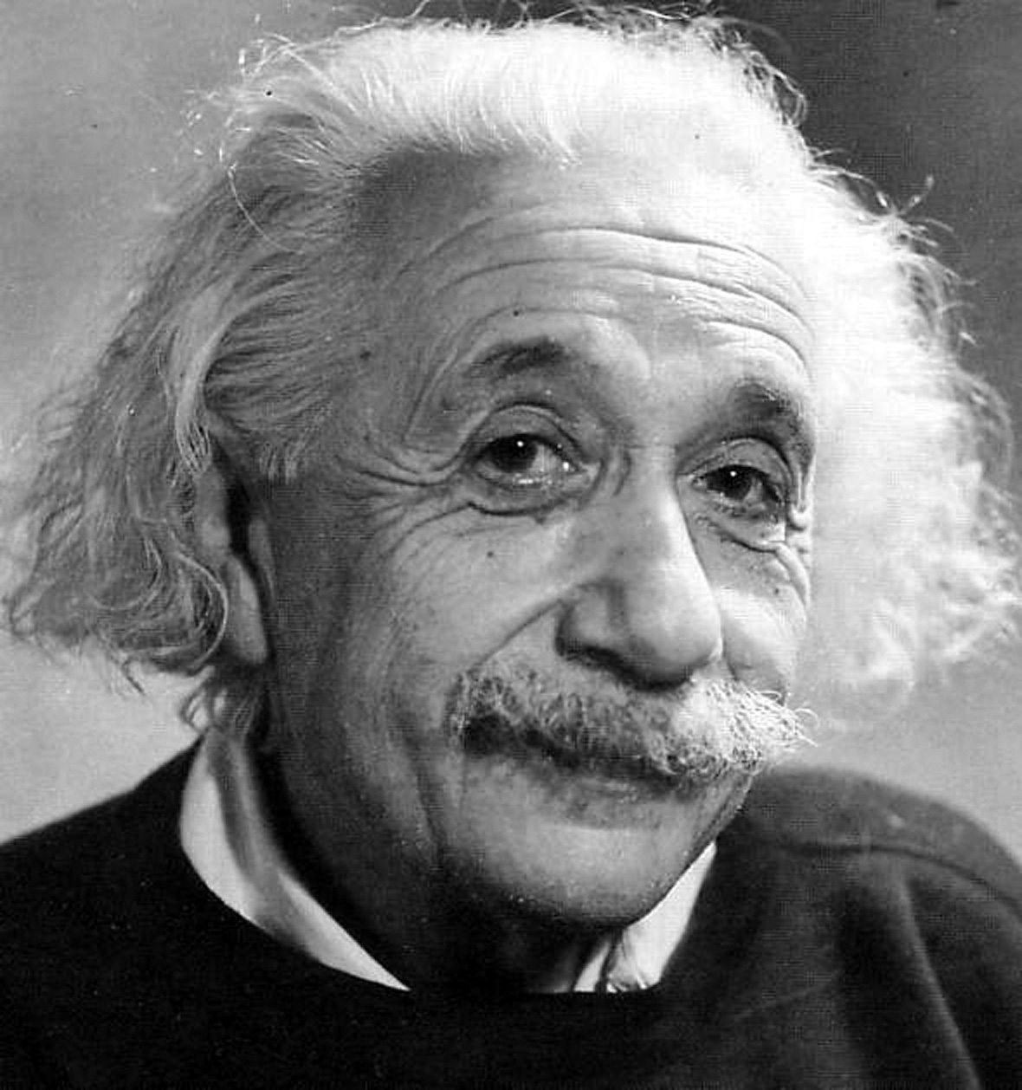
Step 1: Rethinking “Truths” That Hinder Growth
1: Rotary will grow if only we can recruit enough new members.
2: Once we induct a new member our membership job is done.
3: Rotary is a box into which new members must learn to fit.
4: There is nothing we can do to keep people from leaving Rotary.

Slide 8
Step 2: Taking a Fresh Look
Recruit> attract
Attendance > engagement /participation
Rigid rules > flexibility and innovation
Fit into our box > Members Are Our Customers

Slide 9
INTRODUCING…
“Our Members Are Our Customers”

Slide 10
“Customers? Rotary? What’s That About? What Difference Does it Make?”
Customer n – 1. “one that purchases a commodity or service.”
Merriam-Webster Dictionary, 2011
Notes:
The Merriam-Webster online dictionary defines a “customer” as “one that purchases a commodity or service”.
Beneficiaries of Rotary club service projects are not a purchaser of anything. They are the beneficiaries of the actions of Rotarians in clubs. A Rotary club can survive without service beneficiaries, who may be unspecified or who may change over time. However, Rotary clubs cannot survive without their customer.
There is one group without whom a Rotary club cannot survive.

Slide 11
Strong Businesses …
Understand customers’ needs and desires;
Provide superior products and service that customers want;
Change to adapt to customers’ changing wants and needs;
Give value to their customers!
Notes:
A strong business: (1) knows who their customers are, (2) understands their customers’ needs, (3) provides a superior product, and (4) knows and protects its niche, or distinctive position in the market.

Slide 12
Strong Rotary Clubs…
Consider members to be valued customers;
Understand what members want and provide it;
Get regular feedback from members;
Change to accommodate members’ changing desires;
Inspire and motivate members to participate.

Slide 13
Our Members Are Our Customers - The Basics
Members are a Rotary club’s customers!
Every member joins and stays in Rotary for a reason – to get or accomplish something (value) .
Members remain in Rotary if they get what they want from it and leave if they don’t.
Club leaders must learn what their members want and provide it.
Clubs must continually self-evaluate and be willing to change to ensure continued member satisfaction.

Slide 14
It’s Official!
May, 2012 - RI Board adopted the North American Membership Strategic Plan.
Its key principles:
Members – Rotarians - are Rotary’s “customers”
Increased member satisfaction will increase retention and in turn attract new members
Focus on and promote the significant benefits exclusive to Rotary membership (i.e. value)
Regularly assess member satisfaction and implement changes necessary to increase satisfaction.

Slide 15
INTRODUCING…
“The Value Proposition”
The “Value Proposition”

Slide 16
What the Heck is a Value Proposition?
Rotary asks members to give of their time (attendance and participation) and money (dues, Foundation support, etc.). They expect something of value in return.
Members leave Rotary when they don’t see a sufficient value in membership to justify their commitment of time and money.
To attract and retain members, Clubs must provide members with the value they seek.
Clubs grow when leadership:
is aware of what members want; and
gives members what they want from Rotary; and
has the courage to make changes necessary to keep members involved in and excited about Rotary.

Slide 17
Why Do Members Leave?
Time?
Money?
“Membership is gained and retained when the value of membership to the Rotarian exceeds the cost of membership.”
PDG John Adams, RID 6740

Slide 18
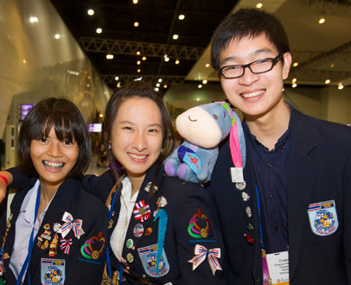
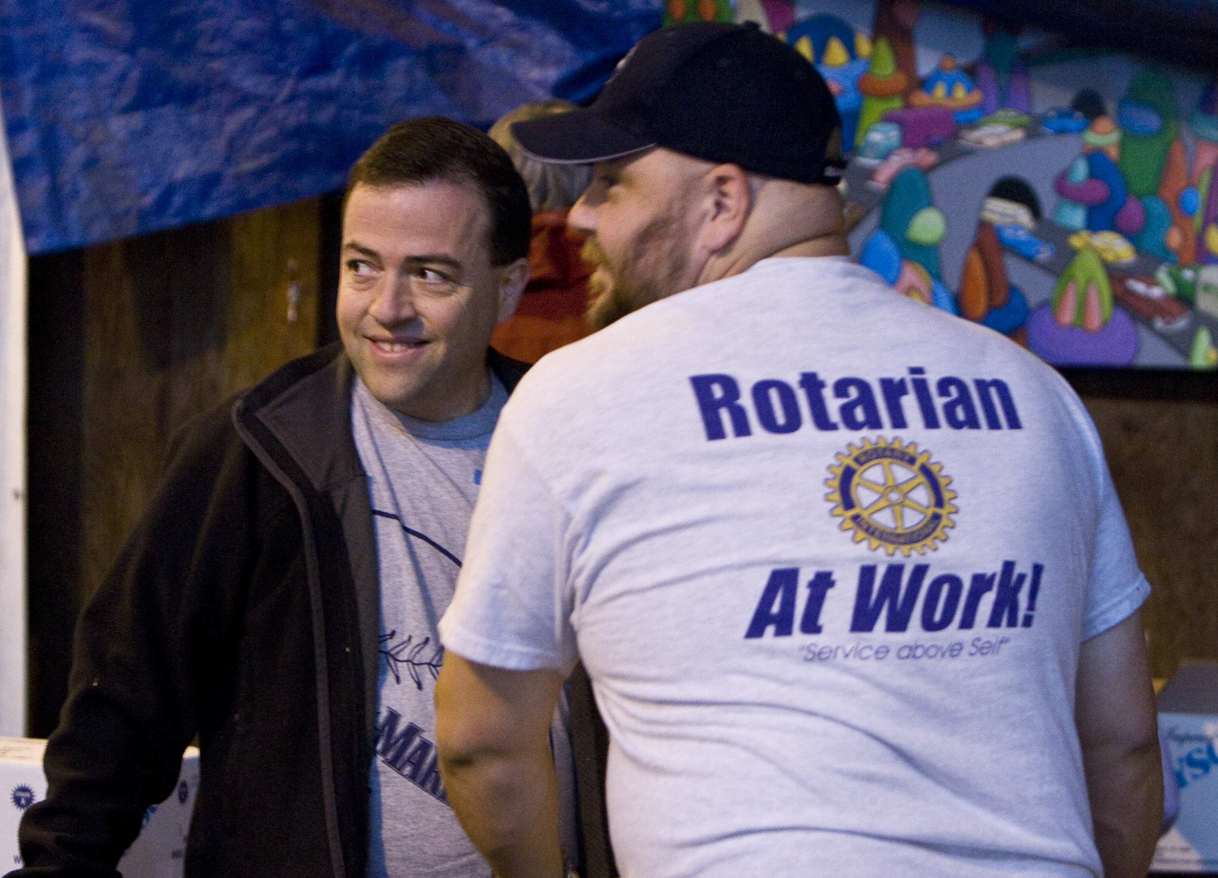
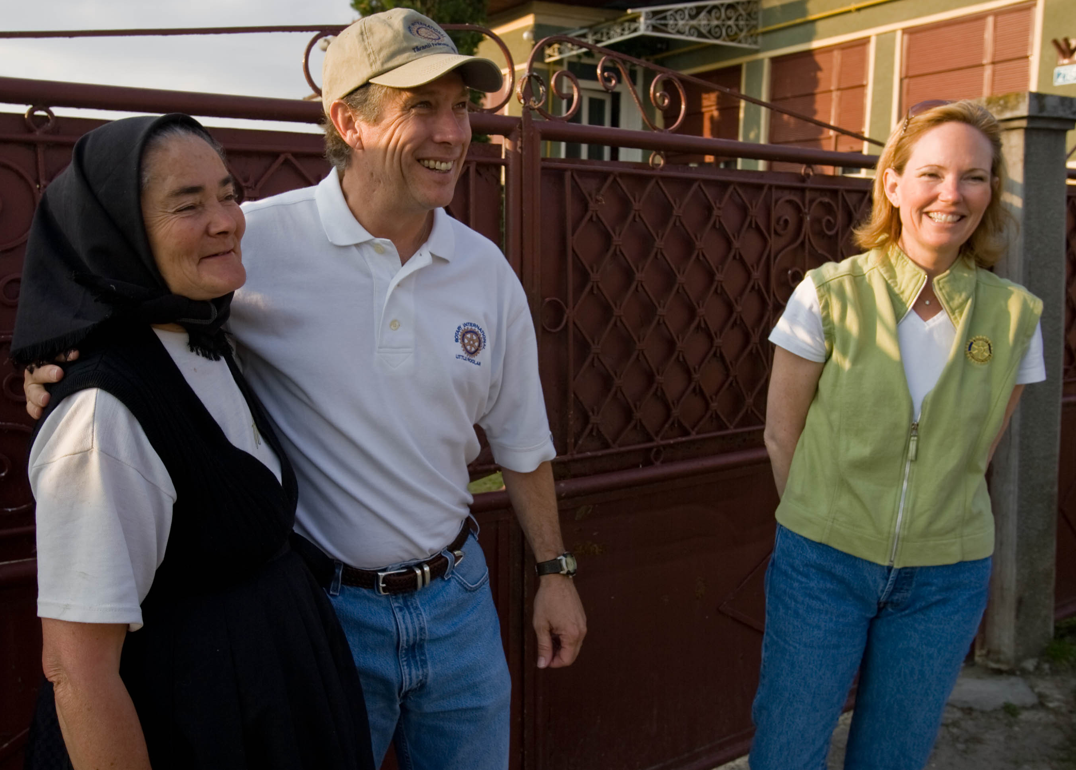
What is Your Club’s Value Proposition?

Slide 19
Who/What Are Rotary’s Competitors?
Not what you think!

Slide 20
Meet Rotary’s “Competitors”
Anything that vies for members’ disposable time is Rotary’s
“competitor. “ People will join and stay only if they believe their
time in Rotary is well spent!

Slide 21
A Question Worth Considering
Why should people join Rotary when they can serve in many settings with no dues or attendance requirements?
(answer coming – stay tuned)

Slide 22
It Starts With Why
Why did you join Rotary?
Why do you remain in Rotary?

Slide 23
Not “One Size Fits All”*
0-5 Year Rotarians | Professional development (leadership, public speaking, etc.) Networking Service with peers
6-20 Year Rotarians | Service to community and world Build and maintain friendships
20+ Year Rotarians | Maintain friendships Service to community World peace
*Source: 2010 Zones 33&34 Survey, RC Bevin Wall & RC Jim Henry
Notes:
As an example, the expressed needs in these general “years in Rotary” groups appeared in a January 2010 survey of 73,000 Zone 33 & 34 Rotarians with email addresses.
0-5 Year Rotarians ranked their primary reasons for being in Rotary as first, Networking, second, Professional Development, and third, Service with Peers.
6-20 Year Rotarians cited first, Service to Community, and second, Maintain Friendships.
Rotarians with 20 or more years indicated first, Maintain Friendships, second, Service to Community and third, World Peace and understanding.
Strong clubs would recognize the very different emphases, programs, projects, and recognitions required solely based on this regional data. Other groups and needs may also be identified by clubs that are sensitized to this issue.
Club specific surveys are also available in the Club Assessment Tools materials available from RI.

Slide 24
Rotary Clubs are Uniquely Situated to Meet their Members’ Needs
Business &
Professional Growth Opportunities
Community Organization
Social Opportunities
Service Club and Volunteers
Work for World Peace
Notes:
Rotary clubs distinguish themselves from their competition for members in many ways. The only thing that limits our Rotary clubs into looking similar to another organization’s club is our inability to express the differences.
We are NOT:
just an “association of business & professional persons”,
just a “community organization”,
just a club of “volunteers”,
just a “service organization”,
just a supporter of “youth”, or
just an advocate for world peace…
We are all of these things and more.

Slide 25
Rotary’s Five Avenues of Service “A Category of One”
Club Service
Vocational Service
Community Service
International Service
Youth Service

Slide 26
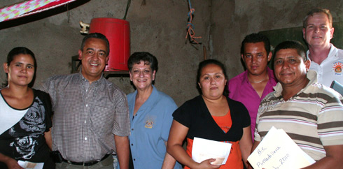
What is Rotary?
“Rotary is a local and global network of selfless people engaged in serving humankind and the personal and professional growth of its members.”*
*Brent’s “elevator speech.” Not copyrighted - feel free to use it!

Slide 27
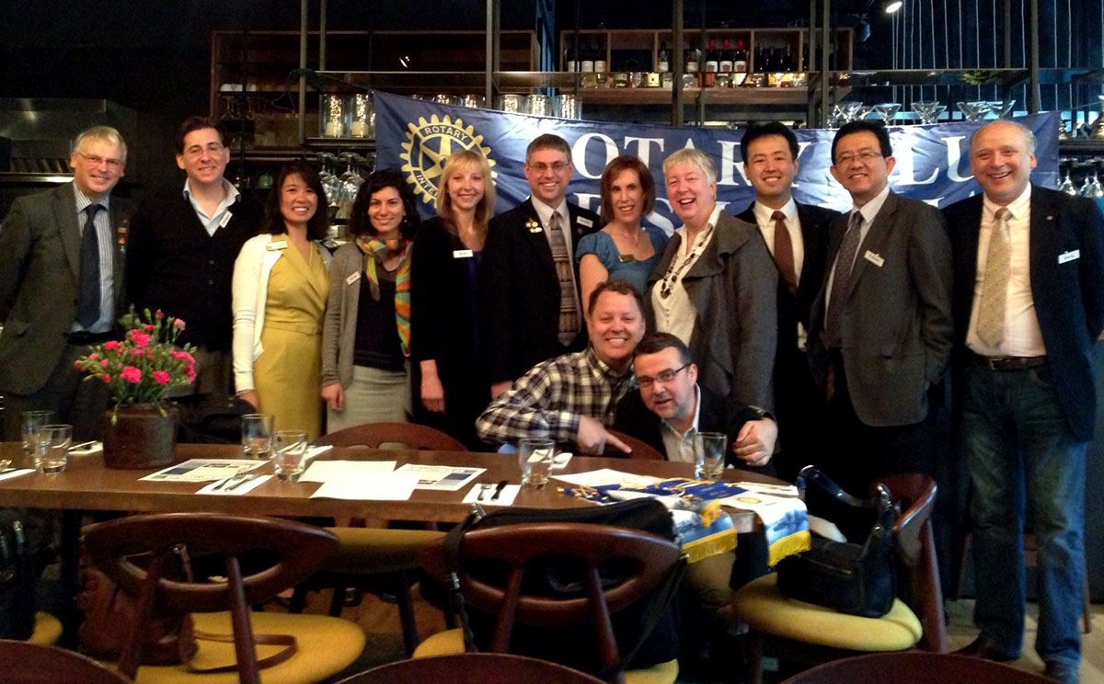
What is Rotary Service?
All of the Club’s activities in all Five Avenues of Service, aimed at improving and enriching lives of those in its community,
the world and in the club!

Slide 28
Why Join Rotary?
Q: Why should people join Rotary when they can serve in many settings with no dues or attendance requirements?
A: Rotary provides members with benefits (value) which can’t be obtained in other single organization: personal and professional development; lasting and meaningful relationships; leadership skills; networking; family involvement; as well as “service” which changes members and the world!

Slide 29
Rotary’s “Attendance” Rules: A Problem? Or an Opportunity?
Multiple Choice Test:
Rotary’s attendance rules are:
A cherished Rotary tradition?
What sets us apart?
An impediment to member attraction and retention?
Out of touch with today’s society?
All of the above
Answer: E – and Misunderstood!!

Slide 30
The “Attendance” Rules Have Changed!
Attend or make up at least 50 percent of regular club meetings; or
engage in club projects for at least 12 hours in each half of the year; or
a combination of both
What counts as a “meeting”?
All official club, district, and RI activities – including service projects, committee meetings, club social events, and even today’s seminar!
(See Standard Rotary Club Constitution Article 9)

Slide 31
Rotary’s Attendance Rules: Participation in club activities is as important as meeting attendance!
Members should attend/participate because they want to, not because we beat them with a rule book!
Members participate when they feel they receive value from it.
Monitor members’ participation and intervene early.
Please forgive my rant: No Rotarian should ever have to leave Rotary for failing to meet attendance requirements!

Slide 32
INTRODUCING…
“The Value Proposition”
Rotary “Touchpoints!”
“Why is a service organization so obsessed with meeting attendance?

Slide 33
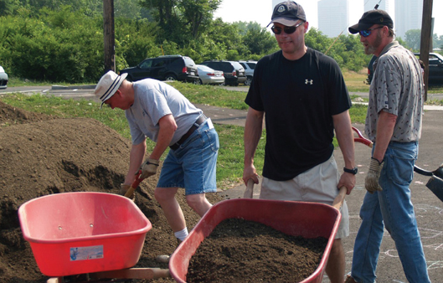
What is a “Touchpoints” Program?
A club program to increase member enthusiasm and participation, create committed Rotarians, and retain and attract members.
Offers increased opportunities for member participation and encourages and recognizes outstanding member involvement.
Helps members understand the club’s activities beyond meetings and participate in those of interest to them.
Touchpoints are all club meetings, activities, experiences, and projects across all Five Avenues of Service
Each club’s Touchpoint program is created to meet the unique needs of that club and its members.
District 6690 (Ohio) Rotarians serving their community

Slide 34
How a Touchpoints Program Can Help Your Club
Personalizes members’ Rotary experience
Gives members options for participation and to bring their service passions to the club
Helps members understand and appreciate Rotary service beyond meetings
Increases regular meeting attendance (yes it’s true!) and participation in club events
Helps attract new members and retain all members
Revitalizes and re-energizes your club!

Slide 35
The Cycle of Growth
Engagement
Attract
Attraction
Retain
Engage
Value
Retention
Value

Slide 36
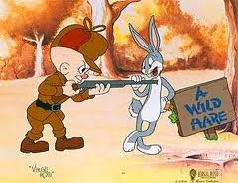
Think:
Attract, not Recruit!*
* Thanks to PDG Chris Jones, Rotary District 7680

Slide 37
Why Attraction?
Creates long lasting relationships instead of short term fixes in numbers.
Recruiting is a short term fix - those that are “recruited” into Rotary usually need to be recruited to do everything else we do, and soon drop out.
If we attract the right people to Rotary and they become engaged, retention takes care of itself.
When we attract the right people, they attract others of the same mindset.

Slide 38
How to Attract
Promote the unique benefits and value of Rotary membership!
Share your Rotary story!
Invite people to a club meeting or event.
Make sure your club has a friendly atmosphere with opportunity for fellowship (exciting programs are a plus but not necessary).
Know and share why/how Rotary is different from other service organizations.
Value starts with the members – does your club
provide what they want?

Slide 39
Step 3: Adopt Best Practices
Learn what potential and current members’ passions are and what they want from Rotary membership.
Do not bring in new members who won’t fit in (refer them to other clubs!).
Pre-induction disclosure of expectations and obligations of Rotary membership.

Slide 40
More Best Practices
Immediately train and involve new members in activities consistent with their passions.
Groom new members for leadership roles.
Continual feedback from members about satisfaction with the club.
Make changes to ensure members’ continued satisfaction: projects, activities, even meeting times!

Slide 41
More Best Practices
Strive to be strong in all Five Avenues of Service and adopt a Touchpoints program.
Have the courage to change traditions that drive away members.
Increase your club’s “value proposition” – focus on value to members!
Embrace change as good! Cultivate an atmosphere of entrepreneurship, progress, optimism and excitement.
Membership growth is a matter of whole club excellence, not just numbers!

Slide 42
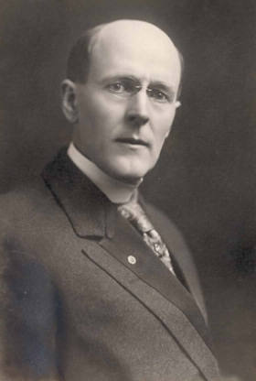
We Encourage:
Vocational Service and networking events
Club social events (aka “Club Service”) – on a regular basis
Family friendly activities
“Flexible and Innovative” meeting schedule
“Touchpoints”
Networking isn’t a bad thing – it brought me to Rotary!

Slide 43
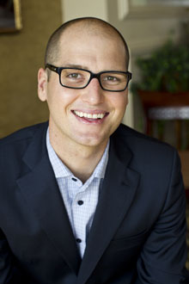
We Encourage:
Engaging the Next Generation in Rotary
We must make Rotary attractive to younger members for Rotary to survive!
Start small.
Build relationships before pushing membership.
Explain the “why” of Rotary. Millenials are outcome focused. Emphasize: Through Rotary, 1 person can change the world!
Avoid emphasizing rules, traditions, and rituals.
Michael McQueen, an authority on
youth trends; member of
Rotary Club of Crows News,
New South Wales, Australia.

Slide 44
The Take-away
Members are Rotary’s greatest asset !
The most important issue for all of Rotary is to grow to ensure our continued service both locally and globally.
We must make Rotary more attractive to women, minorities and the millenial generation!
Membership growth can happen if we make it a priority and are willing to make the changes we need to be relevant to the next generation.
Membership growth requires we recognize and treat members as our customers, giving them the value they seek from Rotary.
We are not advocating changing the essence of Rotary:
Service Above Self remains first, last, and always our #1 mission!

Slide 45
Is All This Change Worth It?
YES!! Our communities and the world we serve need a strong and active Rotary! This effort isn’t just about us. It’s about continuing and growing our mission of Service Above Self to a world which desperately needs the help, hope, and opportunity only Rotary can provide!

Slide 46
THANK YOU! For more information…
PDG Brent D. Rosenthal Assistant Rotary Coordinator, Zone 30 brent.rosenthal1@gmail.com (614) 595-8424

