Slide 1
Presidential Membership Summit
Zone 21b/27
Membership Growth and Retention
PDG Lisa Faith Massey
District 5890

Slide 2
Membership
Growth and Retention
Brief overview of membership growth
Membership Retention

Slide 3
Membership Growth
Young Professionals, Women, Retirees, & Rotary Alumni
Why are they joining?
  Service Opportunities
  Fellowship
  Networking
Successful growth results from setting a goal while having an organized plan to achieve that goal
Improved retention is the result of a strong membership plan

Slide 4
Membership Retention
Retention = Vibrancy
The Vibrant Club
  Service
  Fellowship
  Fun
  Flexible
  Innovative
  Relevant
The Vibrant District
Leadership
Fellowship
Active
Innovative
Support
Relevant

Slide 5
Membership Retention
Club Level
Plan on how to retain members
Provide the ‘’unknown’’ reasons for joining & staying in Rotary
Leadership Development
Mentoring
Opportunity to follow their passion
Life changing experiences
Encourage participation in District events
Allow members to utilize their strengths

Slide 6
Membership Retention
Membership Cycle
Recruiters
Hosts
Closers
Mentors

Slide 7
Membership Retention
District Level
Leadership- District Governor ‘’Drives the bus’’
District Membership Chair
Strategic Plan
Area Membership Chair
Direct Club involvement
Assistant Governors

Slide 8
Membership Retention
District Level
Support
Membership ‘’Troubleshooter’’
Visioning
Monthly District Membership Meetings
Family of Rotary Events
Quarterly events for the entire family
District Conference
Family Friendly

Slide 9
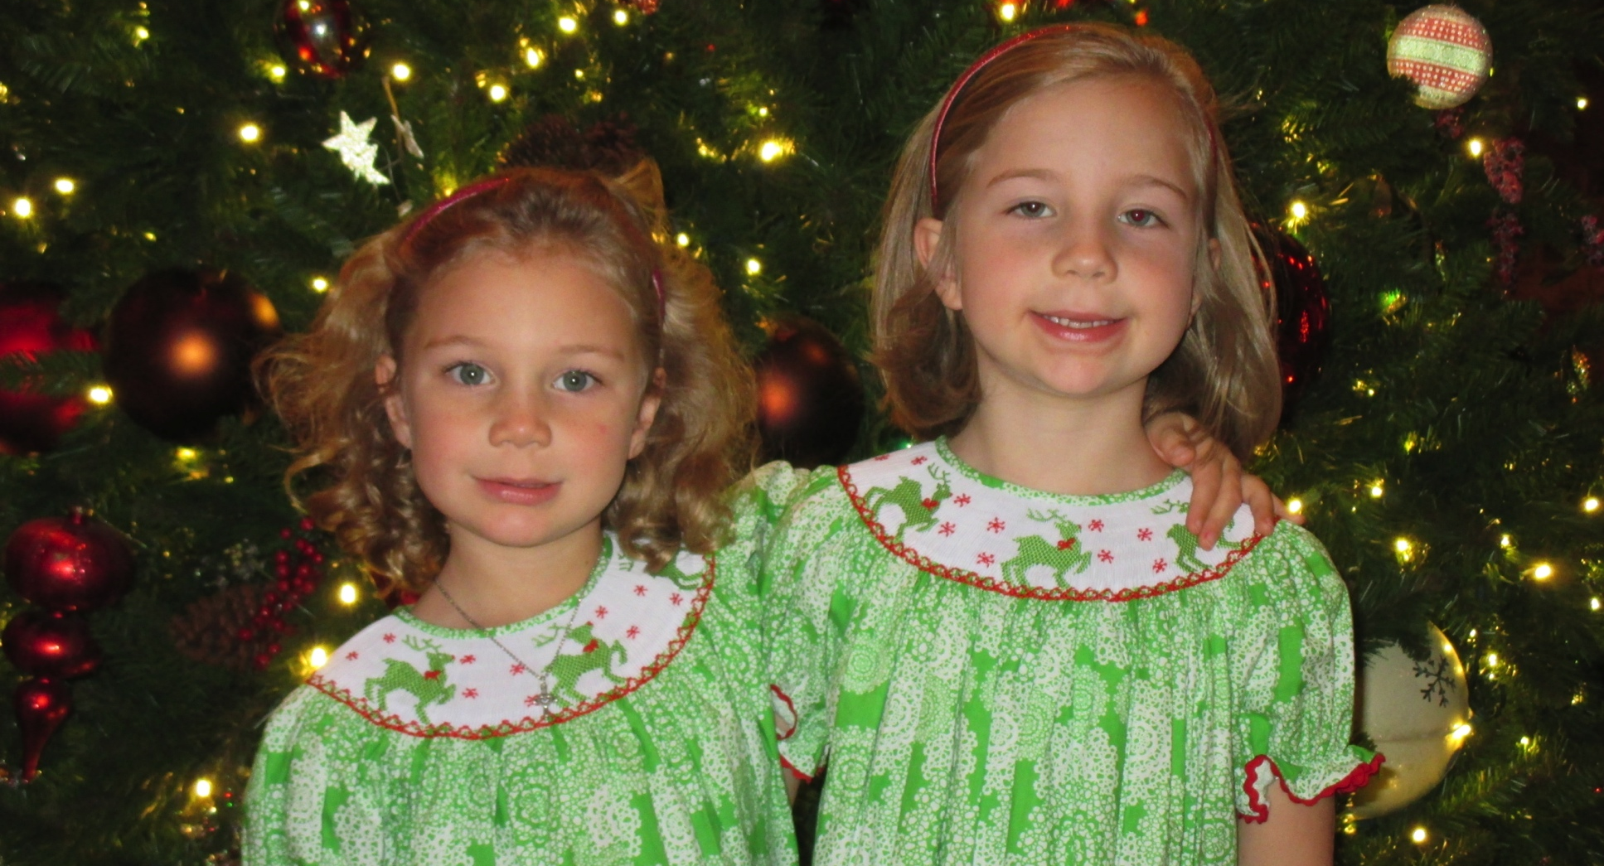
Why is building Rotary important?

